Slide 1
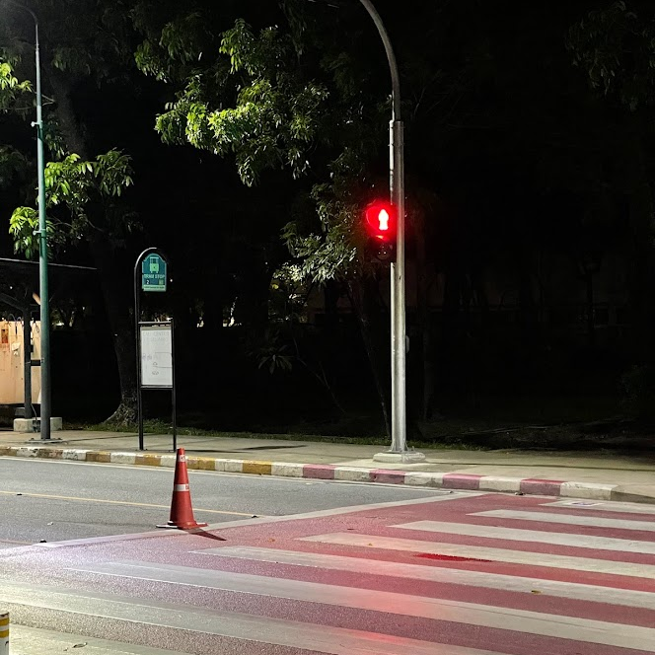

Circular Separable Convolution Depth Of Field
GPU COMPUTE SHADER IMPLEMENTATION IN UNITY HDRP

Slide 2
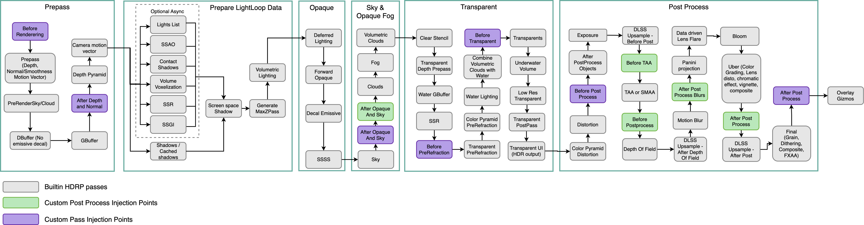
Unity’s High Definition Rendering Pipeline (HDRP)

Slide 3
Unity’s High Definition Rendering Pipeline (HDRP)

Slide 4
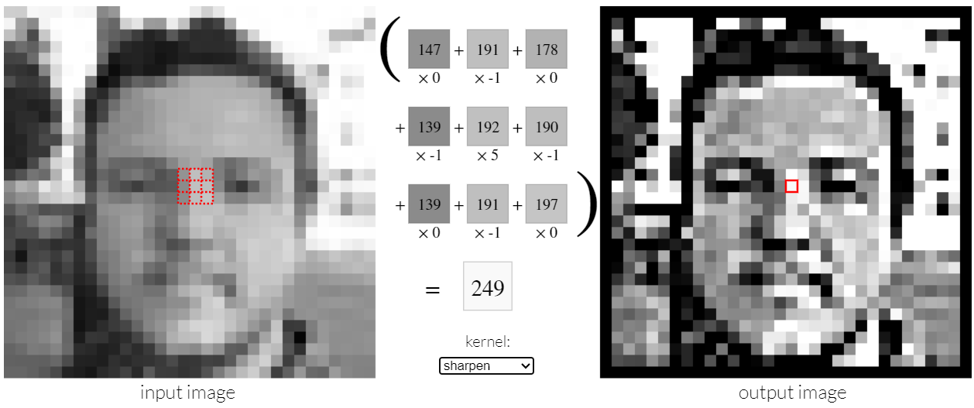

Slide 6
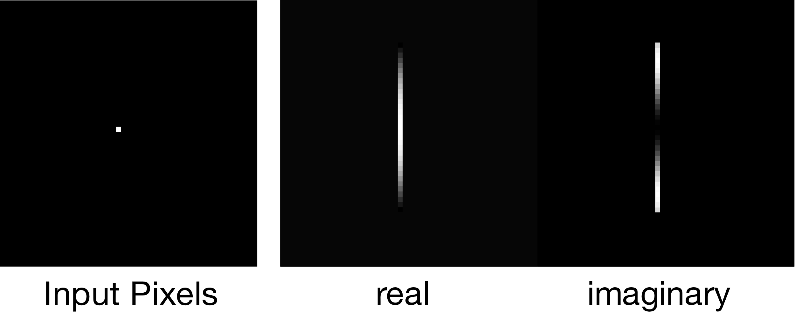
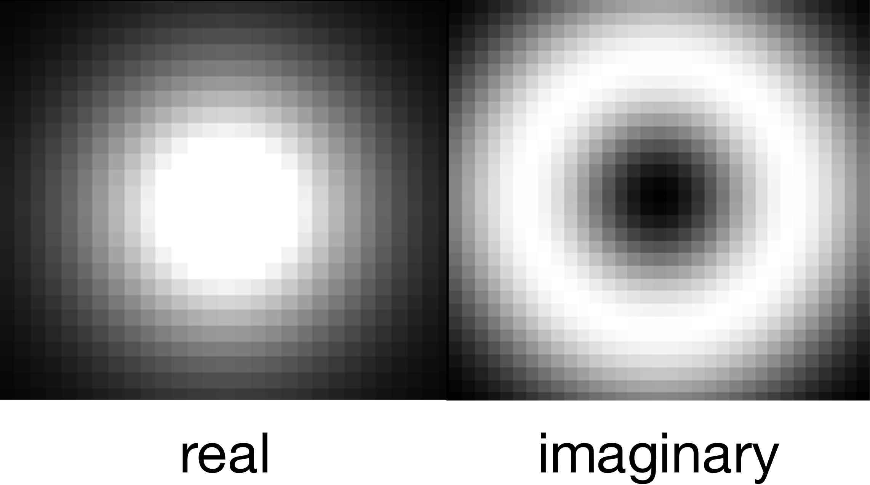

$$F\left(x\right)=e^{−ax^{2}}\left(\cos\left(bx^{2}\right)+i\sin\left(bx^{2}\right)\right)$$
$$Color\left(x\right)=A{∗F}_{real}\left(x\right)+B{∗F}_{imaginary}\left(x\right)$$

Slide 7
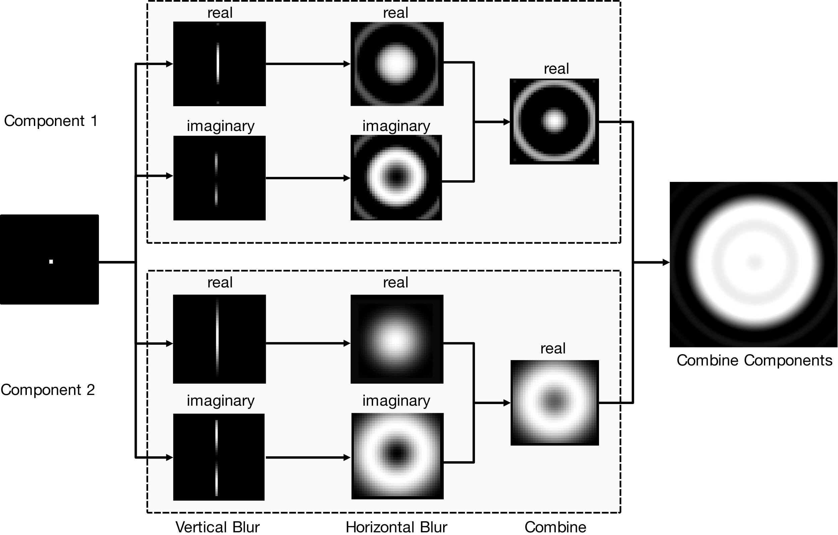

Slide 8
